Slide 1
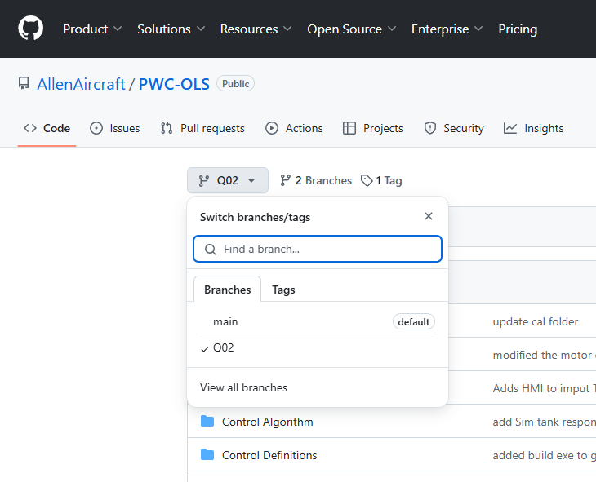
Step 2

Slide 2
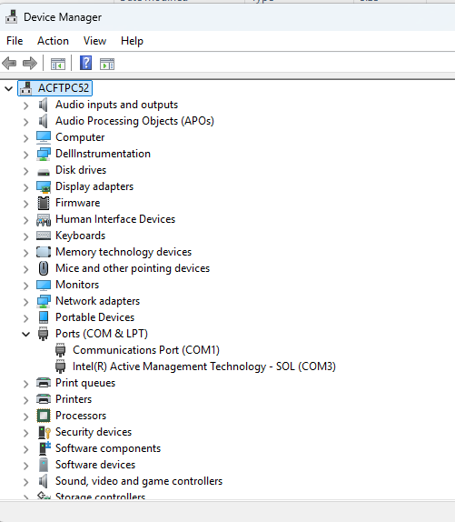
Step 2

Slide 3
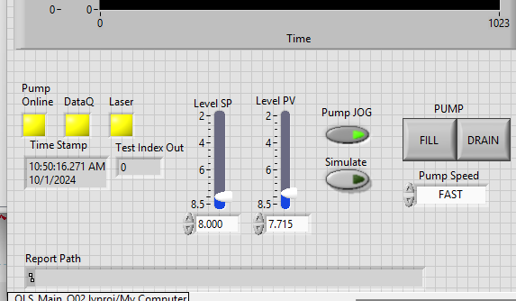
1
2
3
SIM button

Slide 4
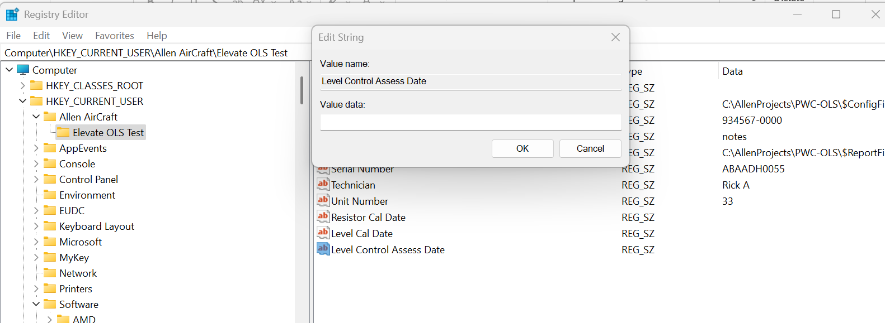
Enter date here
Navigate to this Key
Edit this Value

Slide 5
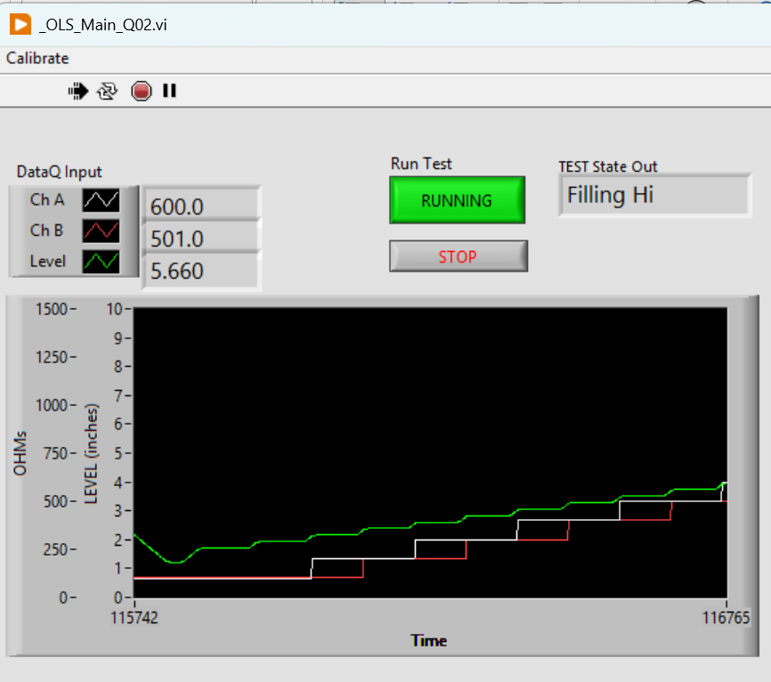
System State and Mode indicator
Click to START or END the automatic Test protocol
STOPS and Exit the application
GREEN Level
WHITE ChA
RED ChB

Slide 6
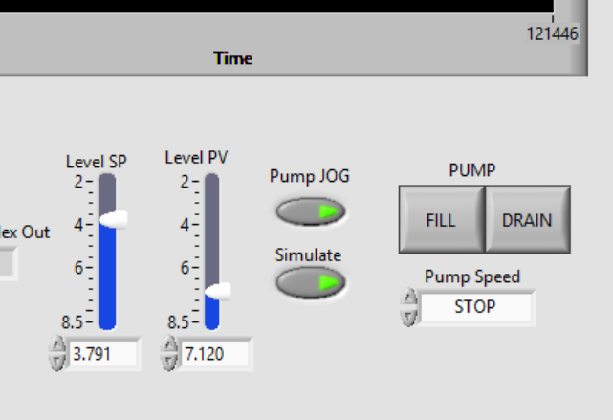
With Pump JOG button:
ON, the FILL and DRAIN buttons and the Pump Speed dropdown control the pump.
OFF then the Level (PV) goes to the SP.
Process Variable (PV) The measured Level.
Set Point (SP) The desired Level in automatic.
NOTE: SP, PV and Level indicate:
Tank is EMPTY when Level ~8.2”
Tank is FULL when Level ~ 2.4”
With Simulate ON, the Level PV and Green Plot should simulate the tank level.

Slide 7
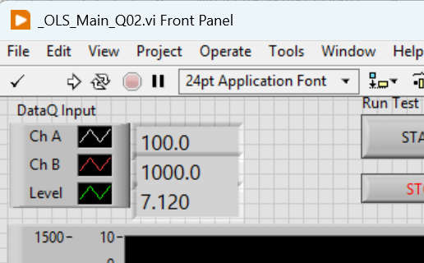
ChA Value.
ChB Value.
Level Value.

Slide 8
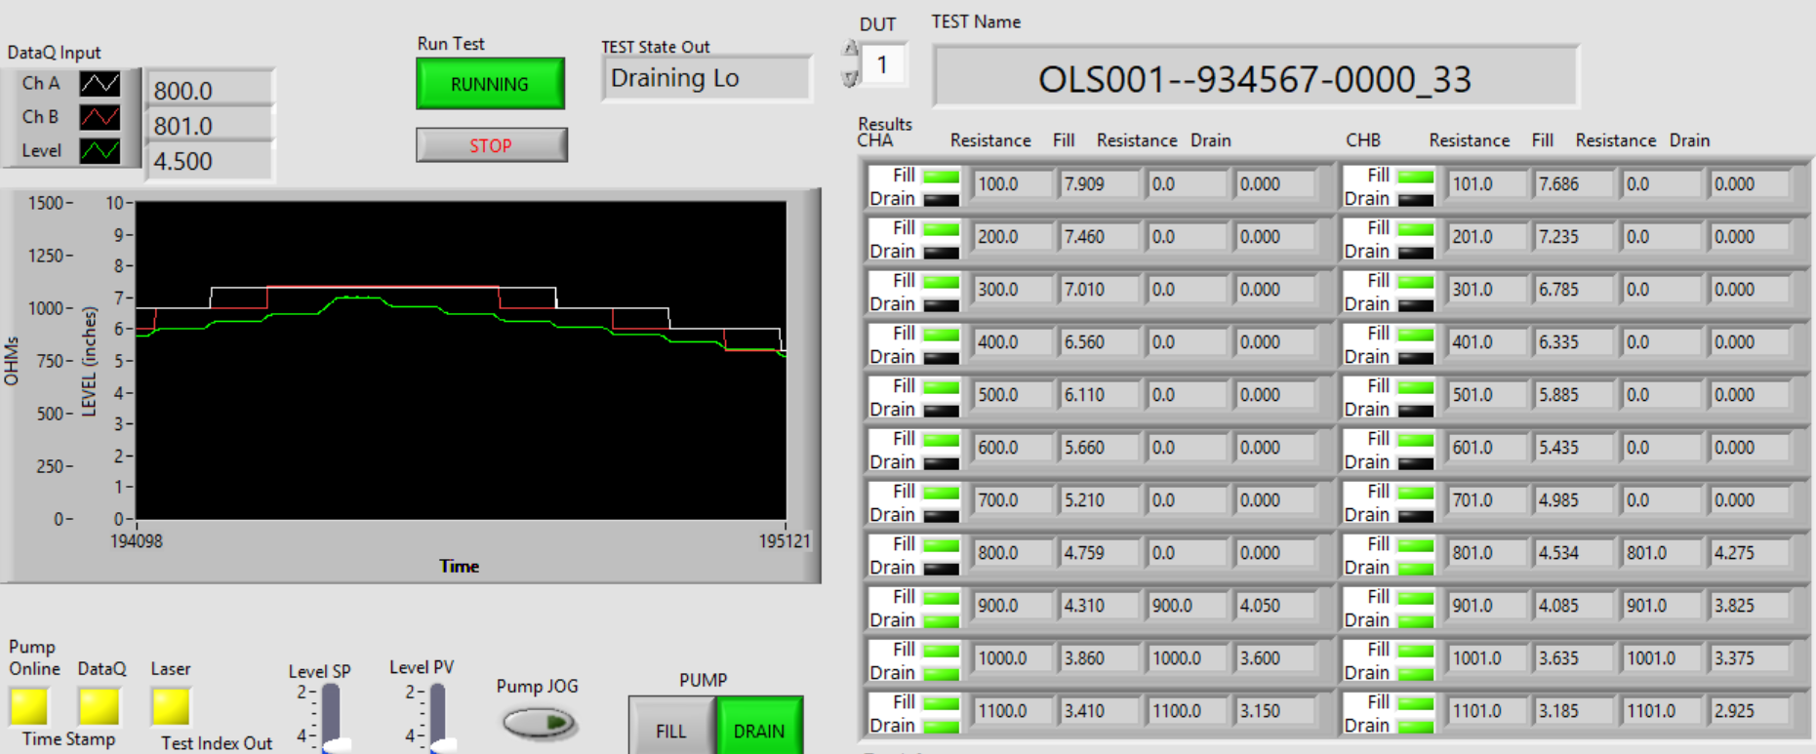
Measured Resistance
(4 places)
Measured Target Test Level
(4 places)
Current Test State
When Running (Green) The test protocol state machine sets the SP in automatic mode to create the stairstep level values.
FILL and DRAIN Status lights,
GREEN = PASS
RED = FAIL
YELLOW = Test Error
BLACK = Not Tested
ChA FILL
ChA DRAIN
ChB FILL
ChB DRAIN

Slide 9
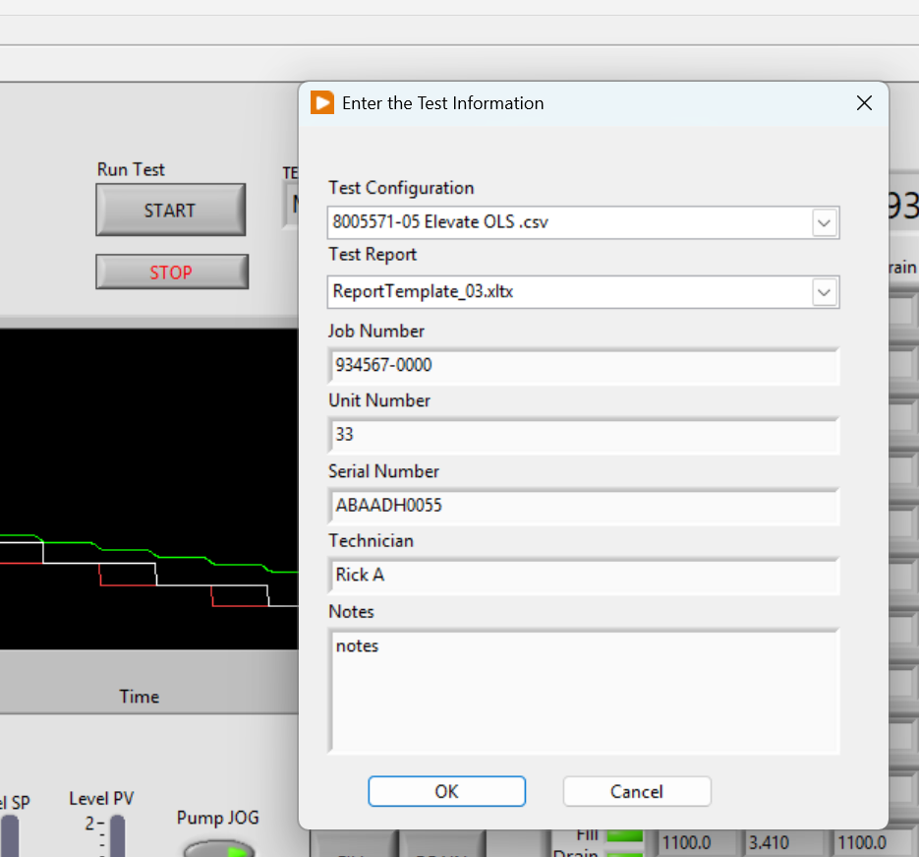
Test Information Dialog
STOP and Exit button.
Test Information Fields (7 Places)

Slide 10
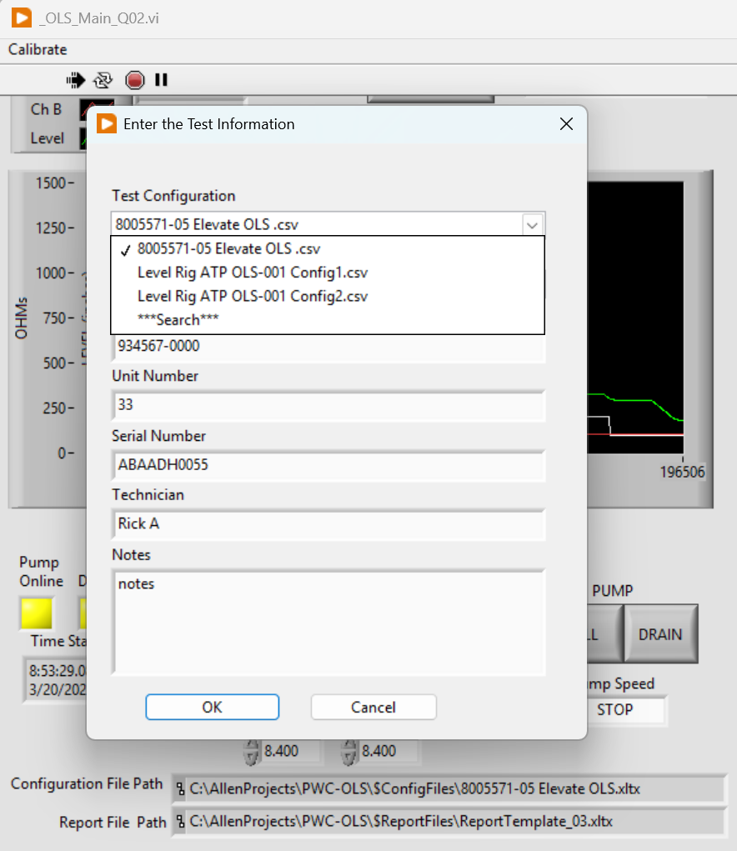
Config File Selection Field
Saved in Register
Currently Selected
Available Selection in current folder
Change Folder
Currently Selected
Full Path & Name

Slide 11
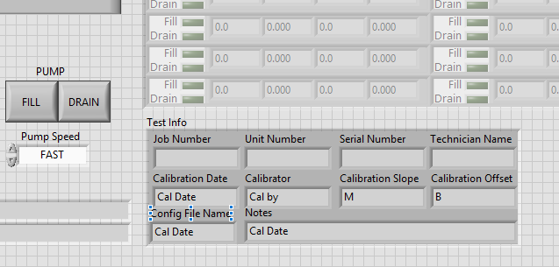
Test Information

Slide 12
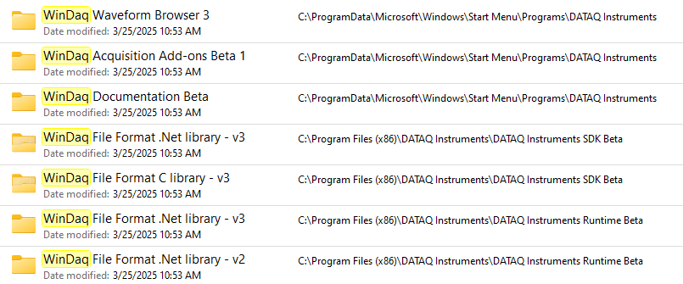
WinDaq Data Acquisition Software
PicoScope oscilloscope software and PicoLog data logging software
Pololu Simple Motor Controller 18v7 (Fully Assembled)

Slide 13
Switching between LibUSB and CDC Modes The native communication mode of the DI-2108-P is LibUSB but it can be switched to the USB CDC (Communication Device Class). CDC mode allows the USB port of DI-2108-P devices to appear like a traditional RS-232 port, which is common across most operating systems and development languages. Please note: LibUSB communication is required for WinDaq Acquisition software and programming with our .NET SDK. Only switch to CDC mode when writing your own programs at the protocol level (for example, Python applications). Use the following sequence to switch your device to/from LibUSB/CDC modes:
Connect the device to your PC via the USB port.
Apply power to the device.
When mode LED stops blinking white and is in Idle mode, push and hold the Control button. This must be completed within five seconds after the device is in Idle mode.
When the mode LED turns red, release the Control button. 5. The Mode LED will flash white then indicate Idle in either LibUSB or CDC mode: • CDC mode: Blinking Yellow • LibUSB mode: Blinking Green

Slide 14
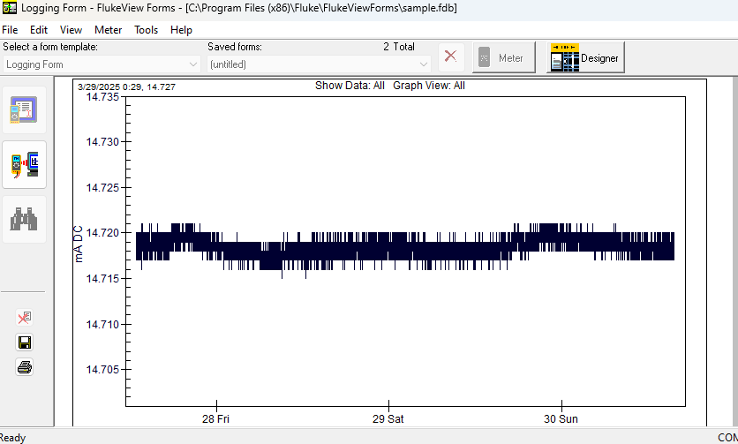
Fluke mA 3/28 to 4/1

